Slide 1
Markdown
Probably the Most Easy-to-Use Markup Language
Presenter: Tairan Li

Slide 2
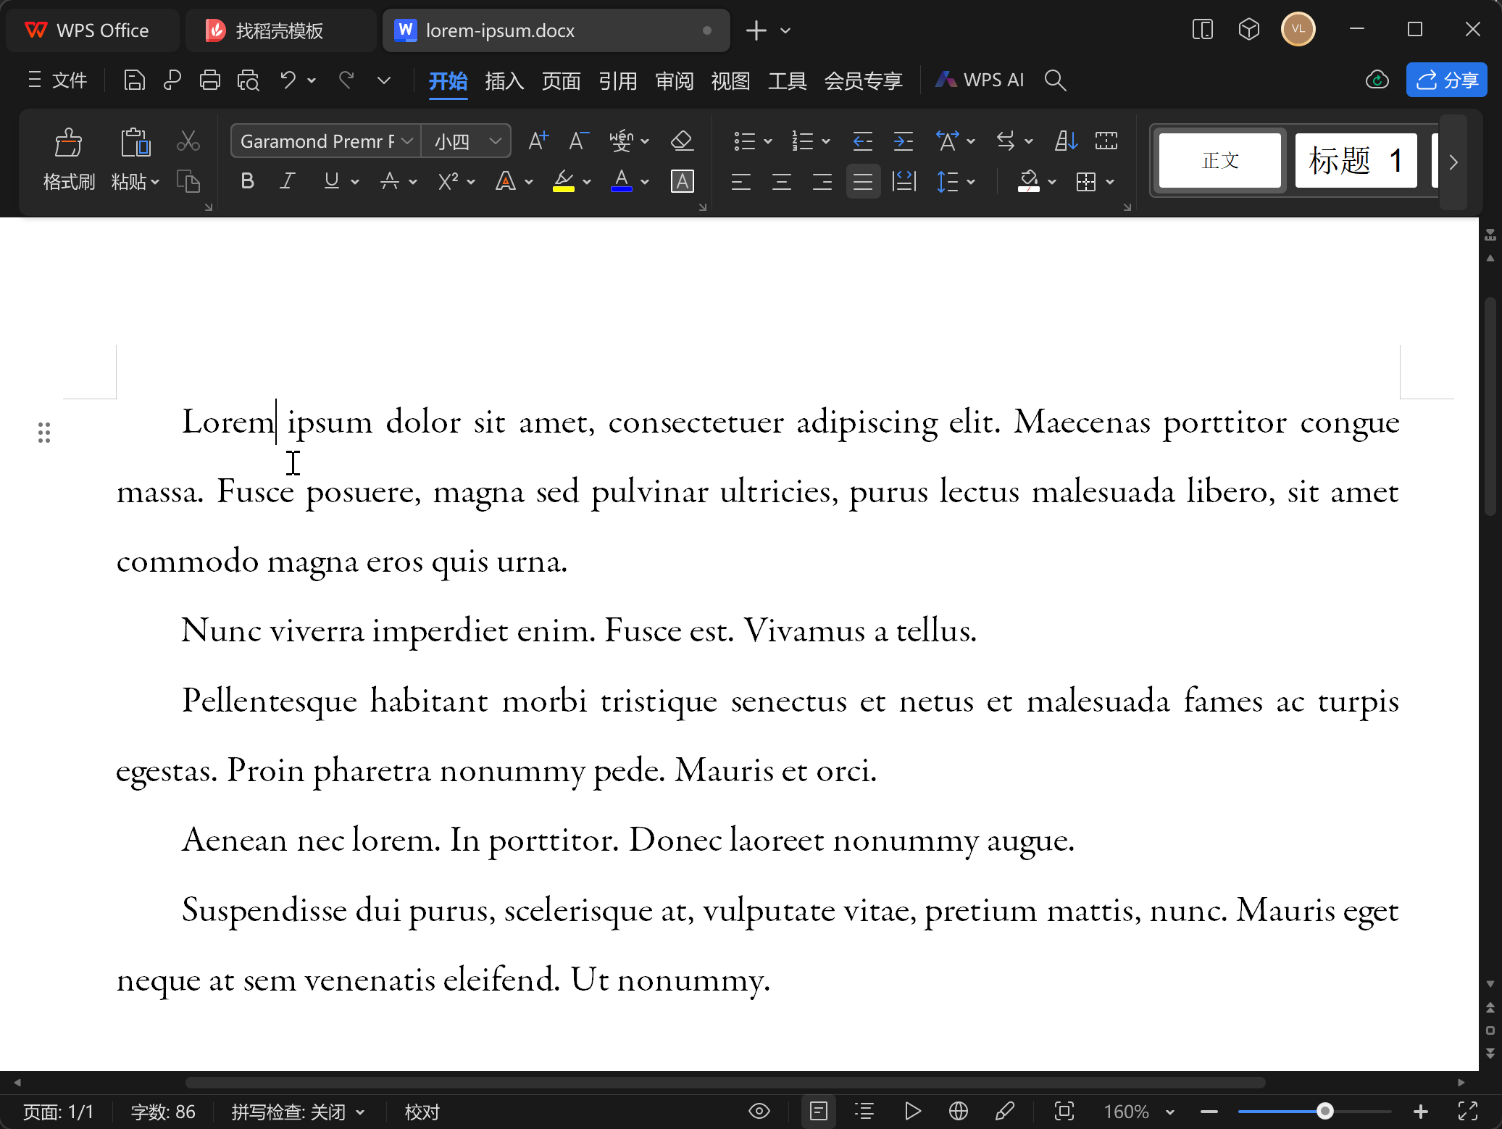


Document Editing
Microsoft Word
Advantages
sophisticated softwares
What you see is what you get (WYSIWYG)
lorem-ipsum.docx
Pages for MacOS
Traditional document-processing softwares

Slide 3
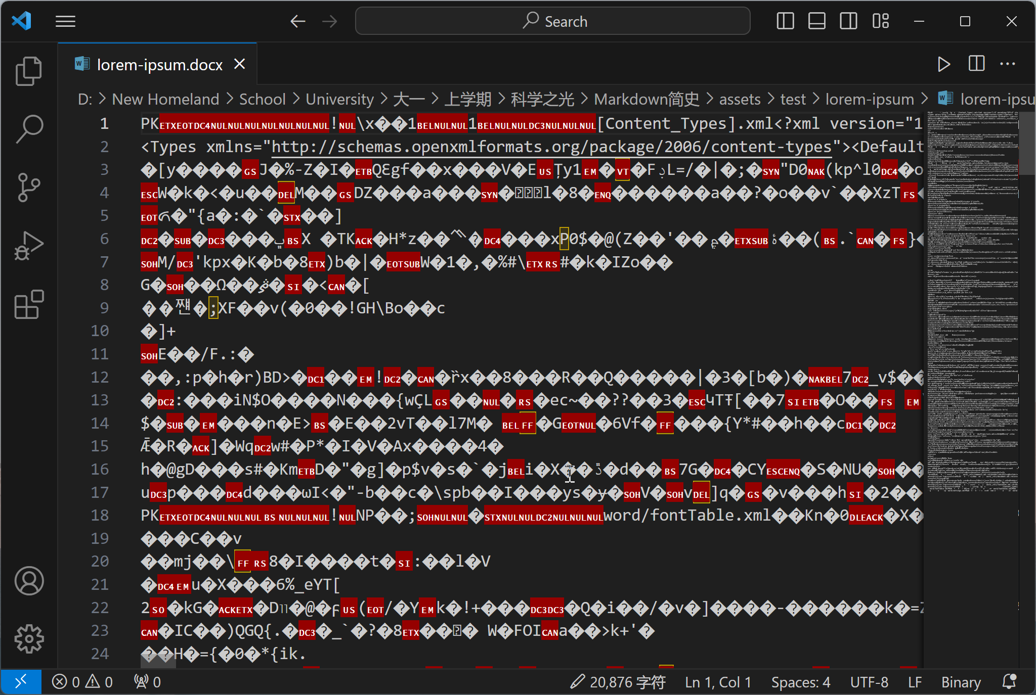
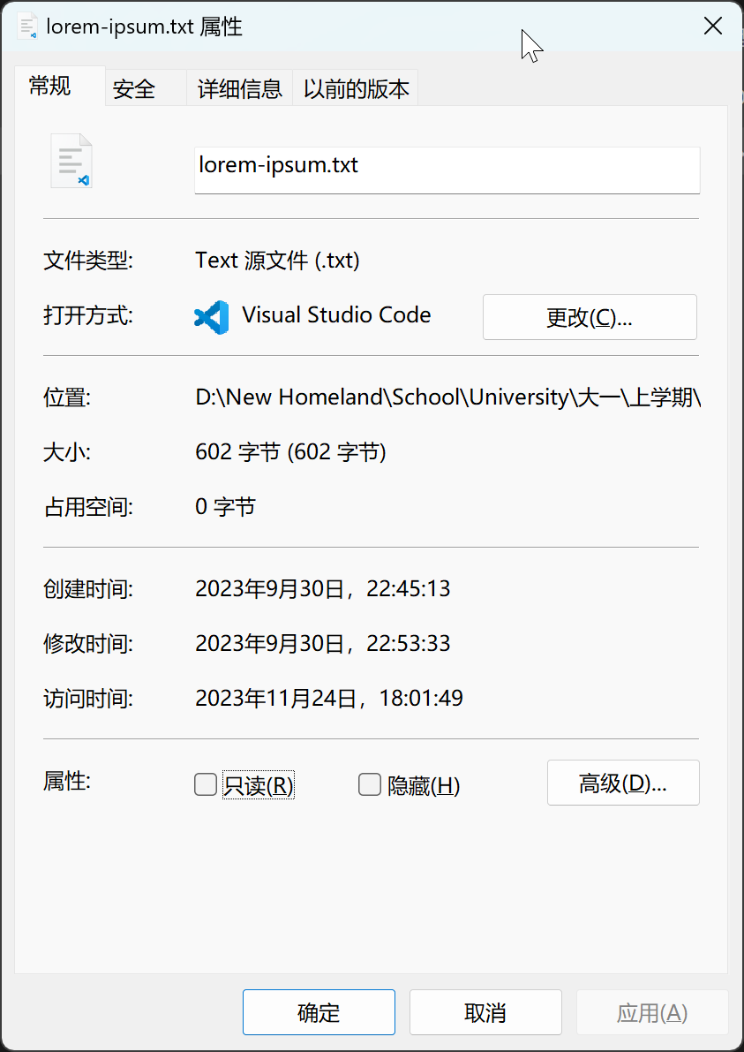
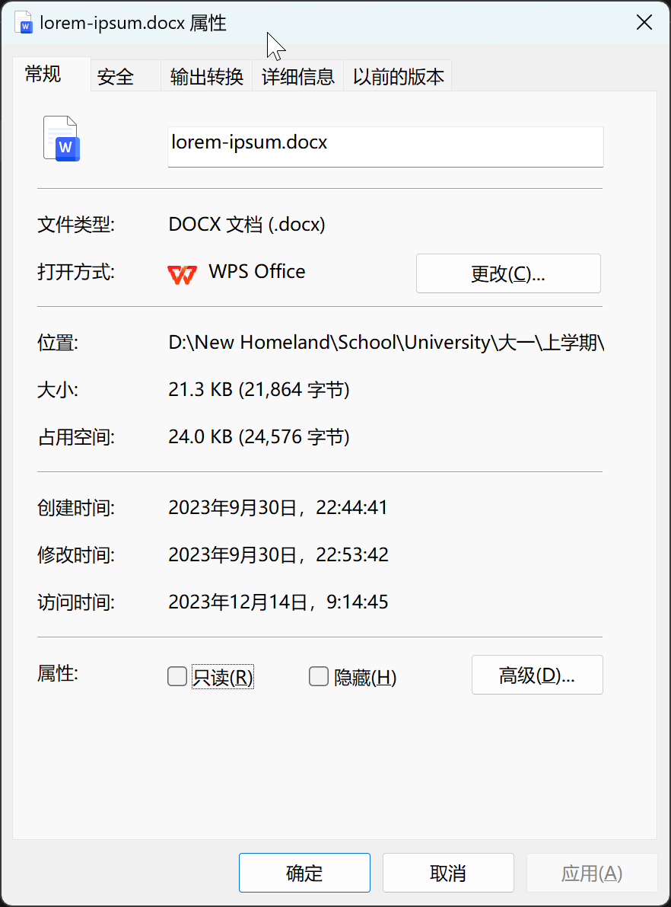
Disadvantages
Not in plain text
(Vulnerable to corruption)
Excessive file size
lorem-ipsum.txt
lorem-ipsum.docx
lorem-ipsum.docx opened with VSCode

Slide 4
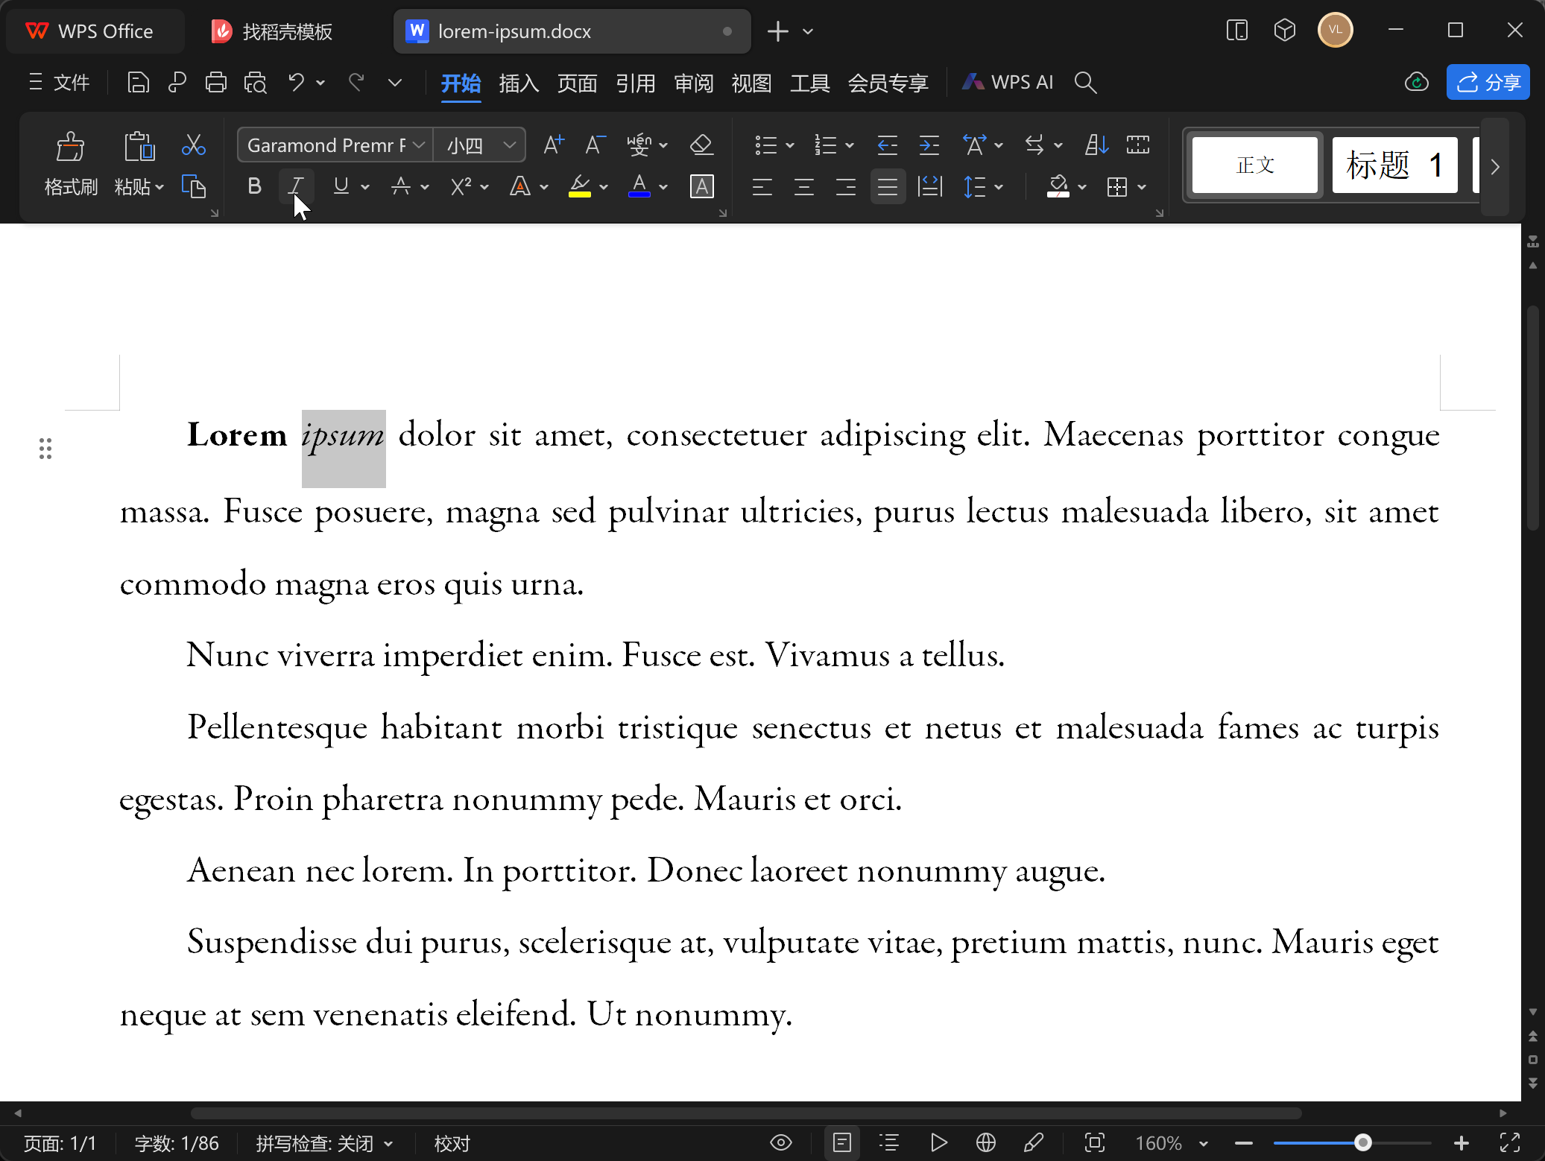
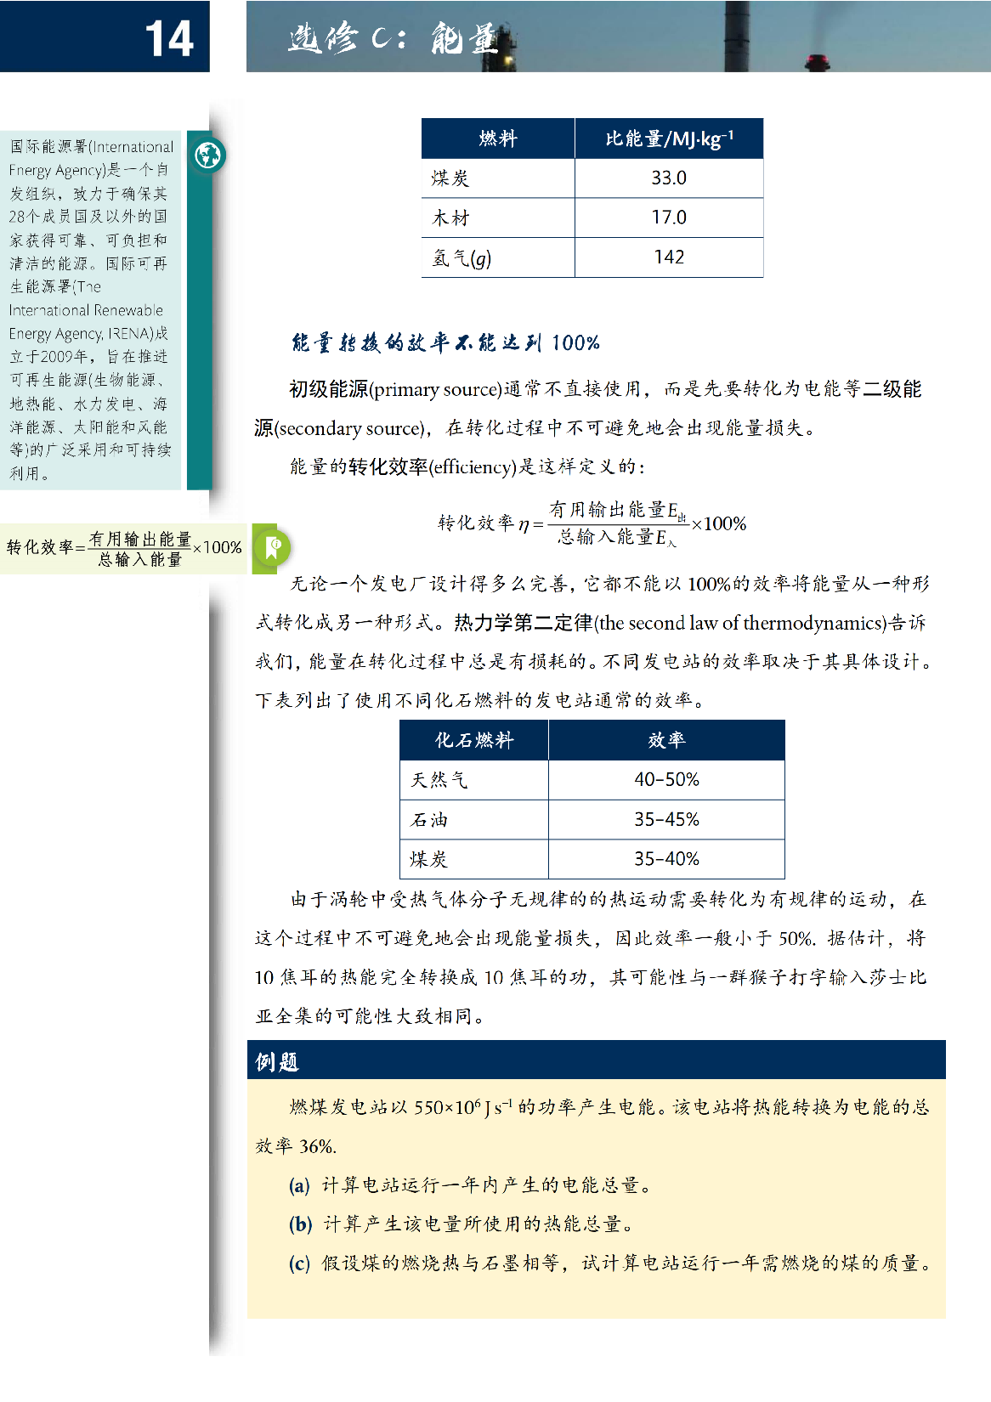
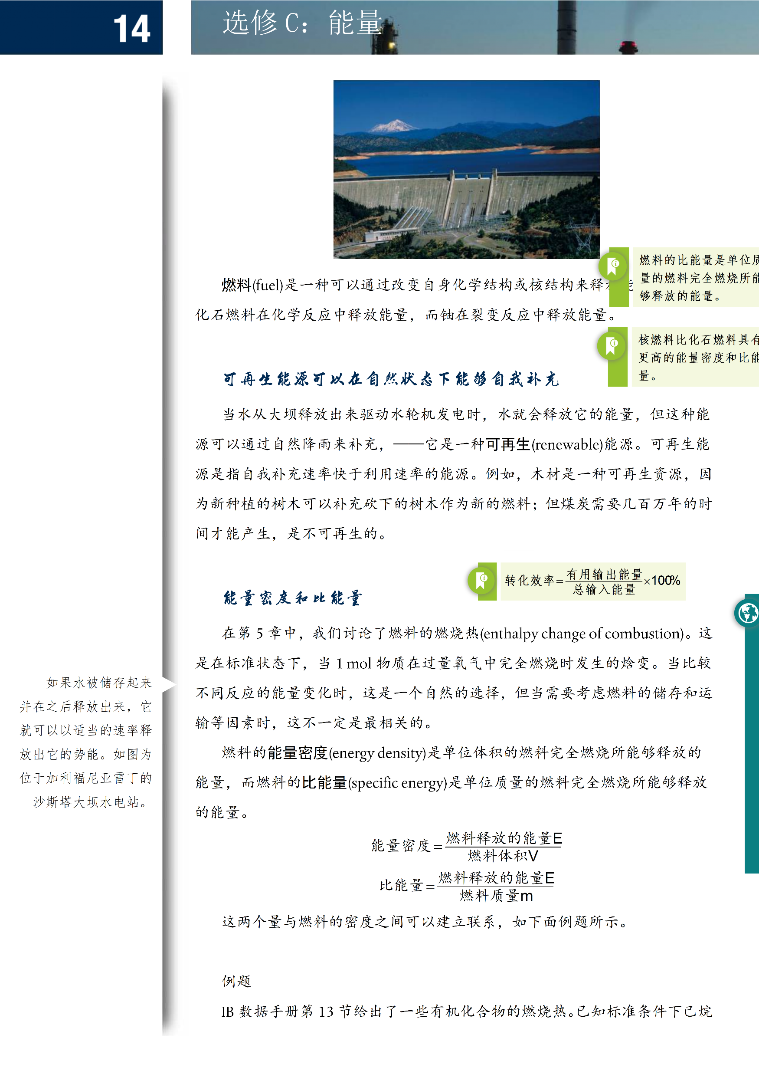

Disadvantages
Messing up contents in complicated layout
Setting formats interrupts editing process
lorem-ipsum.docx
Desired Layout
Messed Up Layout

Slide 5




Markup Languages
Markup language (ML) is a type of programming language that describes the content, format and structure of documents with plain text.
An alternative, resolve the problems of traditional document-processing softwares
Markup languages (MLs)

Slide 6
Markup Languages
An alternative, resolve the problems of traditional document-processing softwares
Plain text format, easy to maintain
Small file size
Produce stable layout
Continuous editing experience with markup syntax
Markup languages (MLs)

Slide 7
Markup Languages
Examples
HTML (HyperText Markup Language)
RTF (Rich Text Format)
WikiText, Powered by MediaWiki
LaTeX, what we use to write our essays
Markdown
Markup languages (MLs)

Slide 8


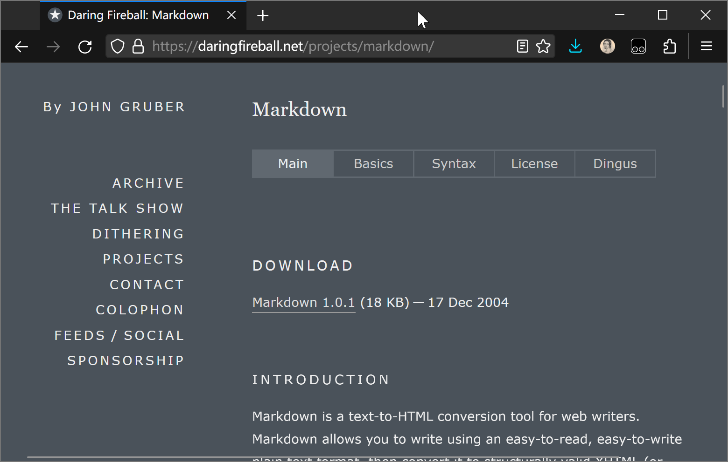
Markdown
https://daringfireball.net/projects/markdown/
John Gruber created Markdown in 2004

Slide 9
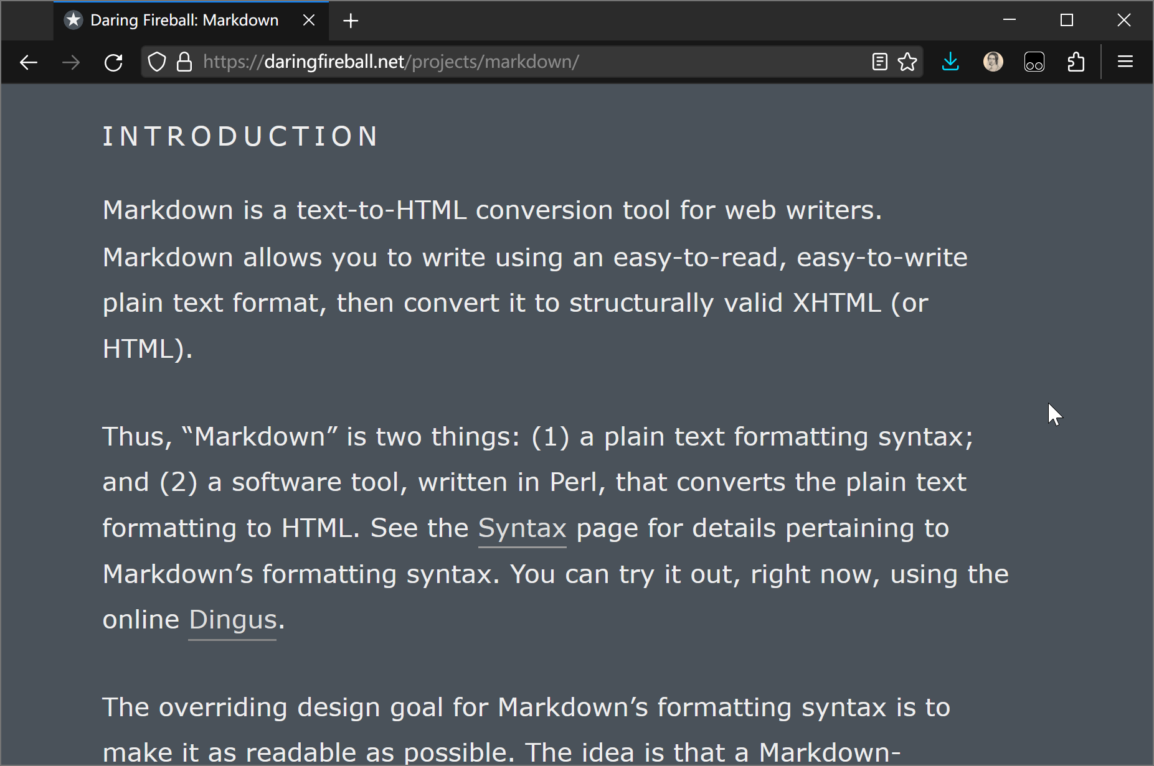
Design Principle: Readability
https://daringfireball.net/projects/markdown/
Markdown is a Lightweight Markup Language (LML)
Markdown allows you to write using an easy-to-read, easy-to-write plain text format, then convert it to structurally valid XHTML (or HTML).
The overriding design goal for Markdown’s formatting syntax is to make it as readable as possible. … as plain text, without looking like it’s been marked up with tags or formatting instructions.

Slide 10
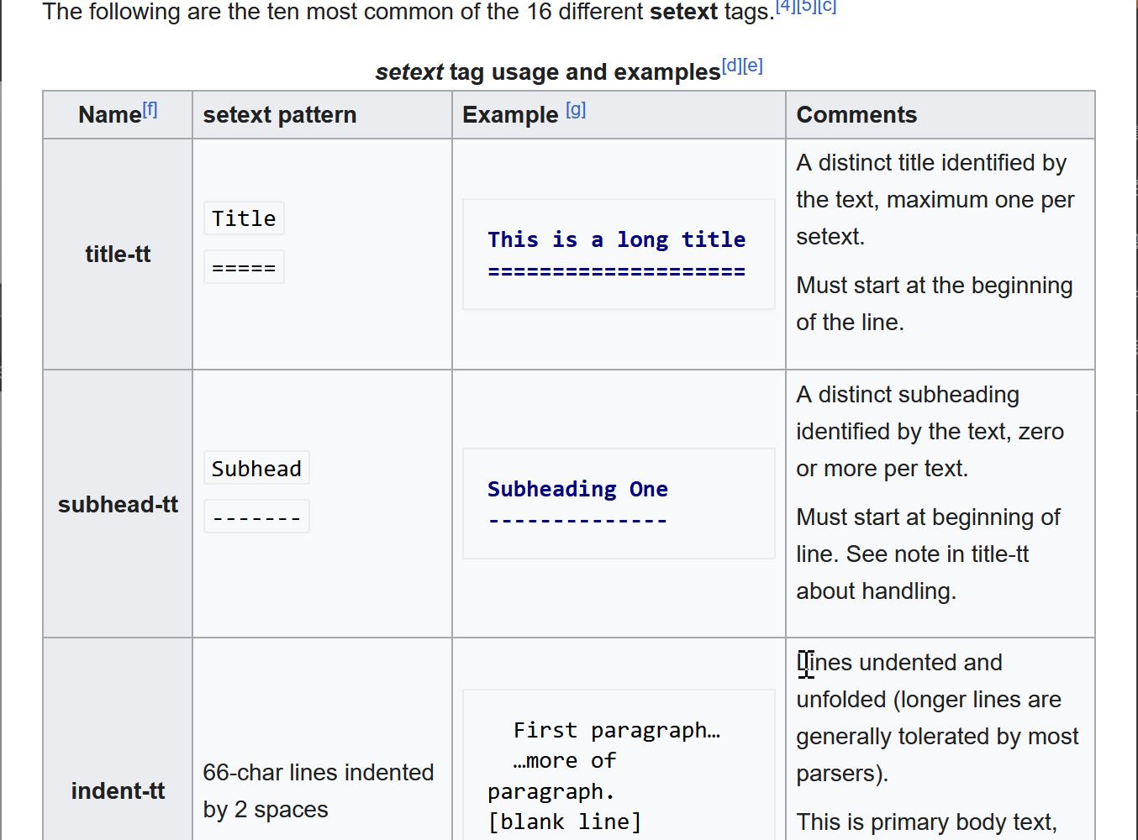
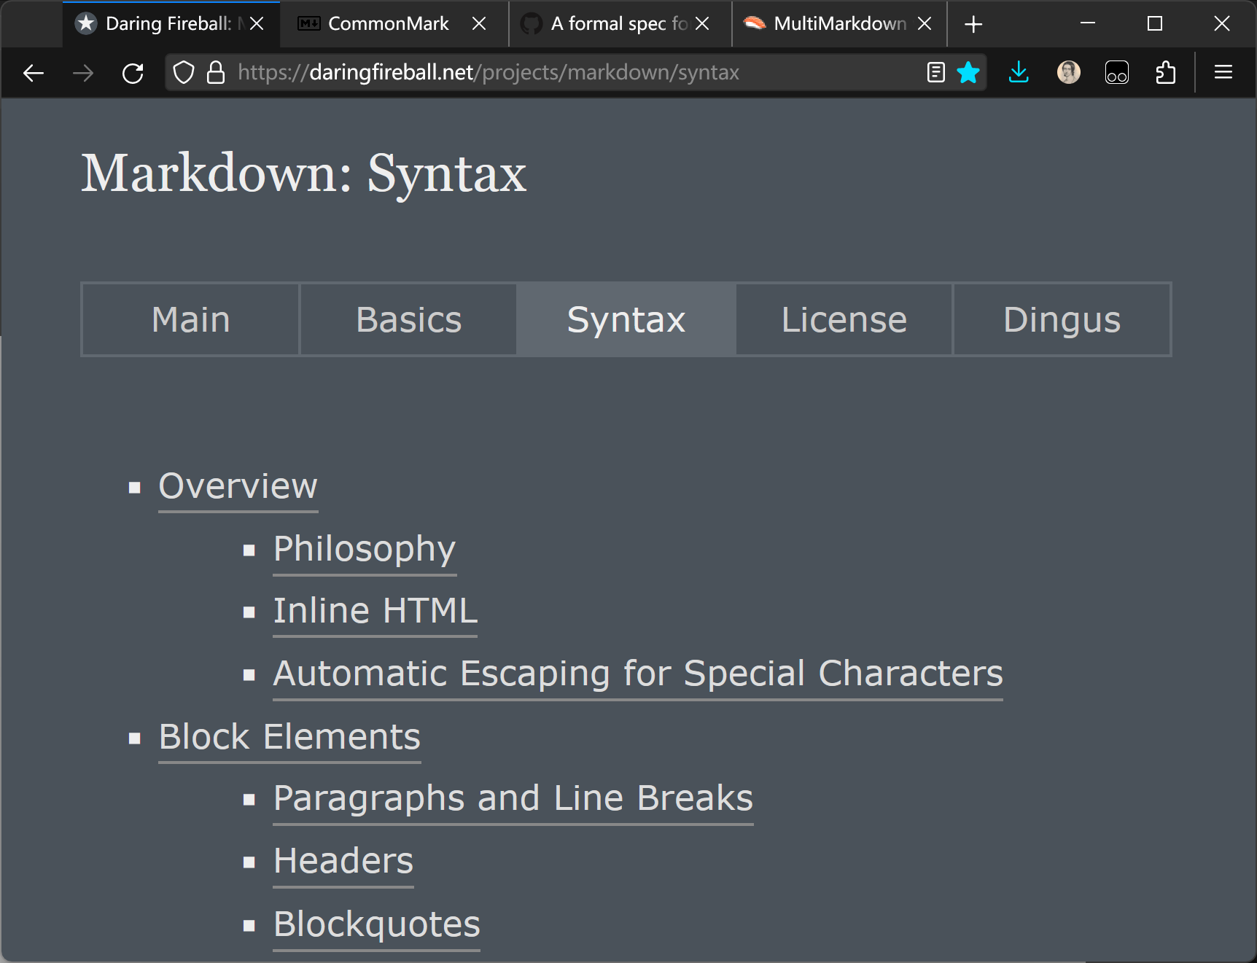
Syntax Evolution
Markdown’s syntax is mainly inspired by early markup languages in email and usenet posts: setex, atx, etc.
Setex
Markdown

Slide 11
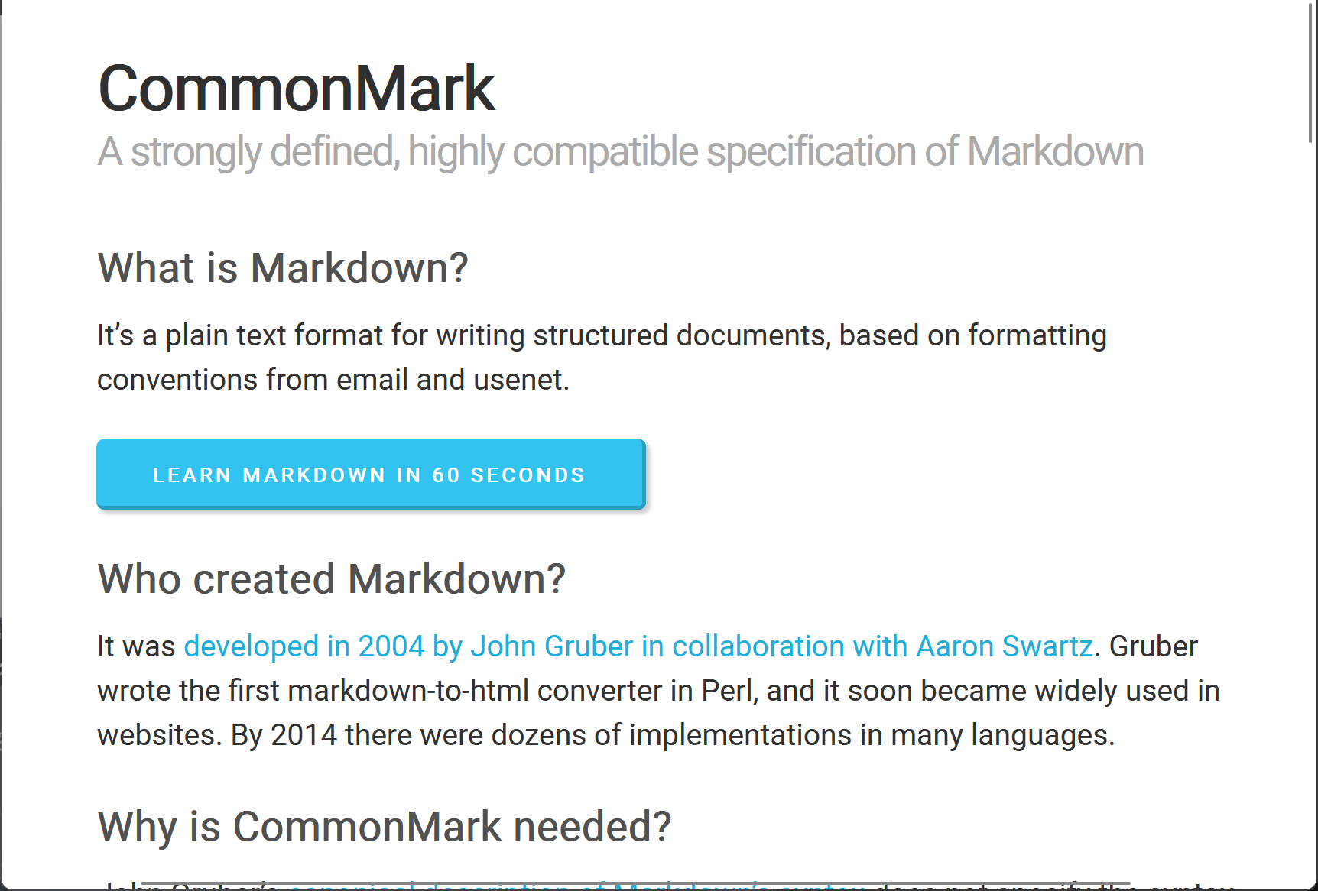
Syntax Evolution
Gruber’s original document
CommonMark
Informal and contains ambiguities
A standardization effort

Slide 12
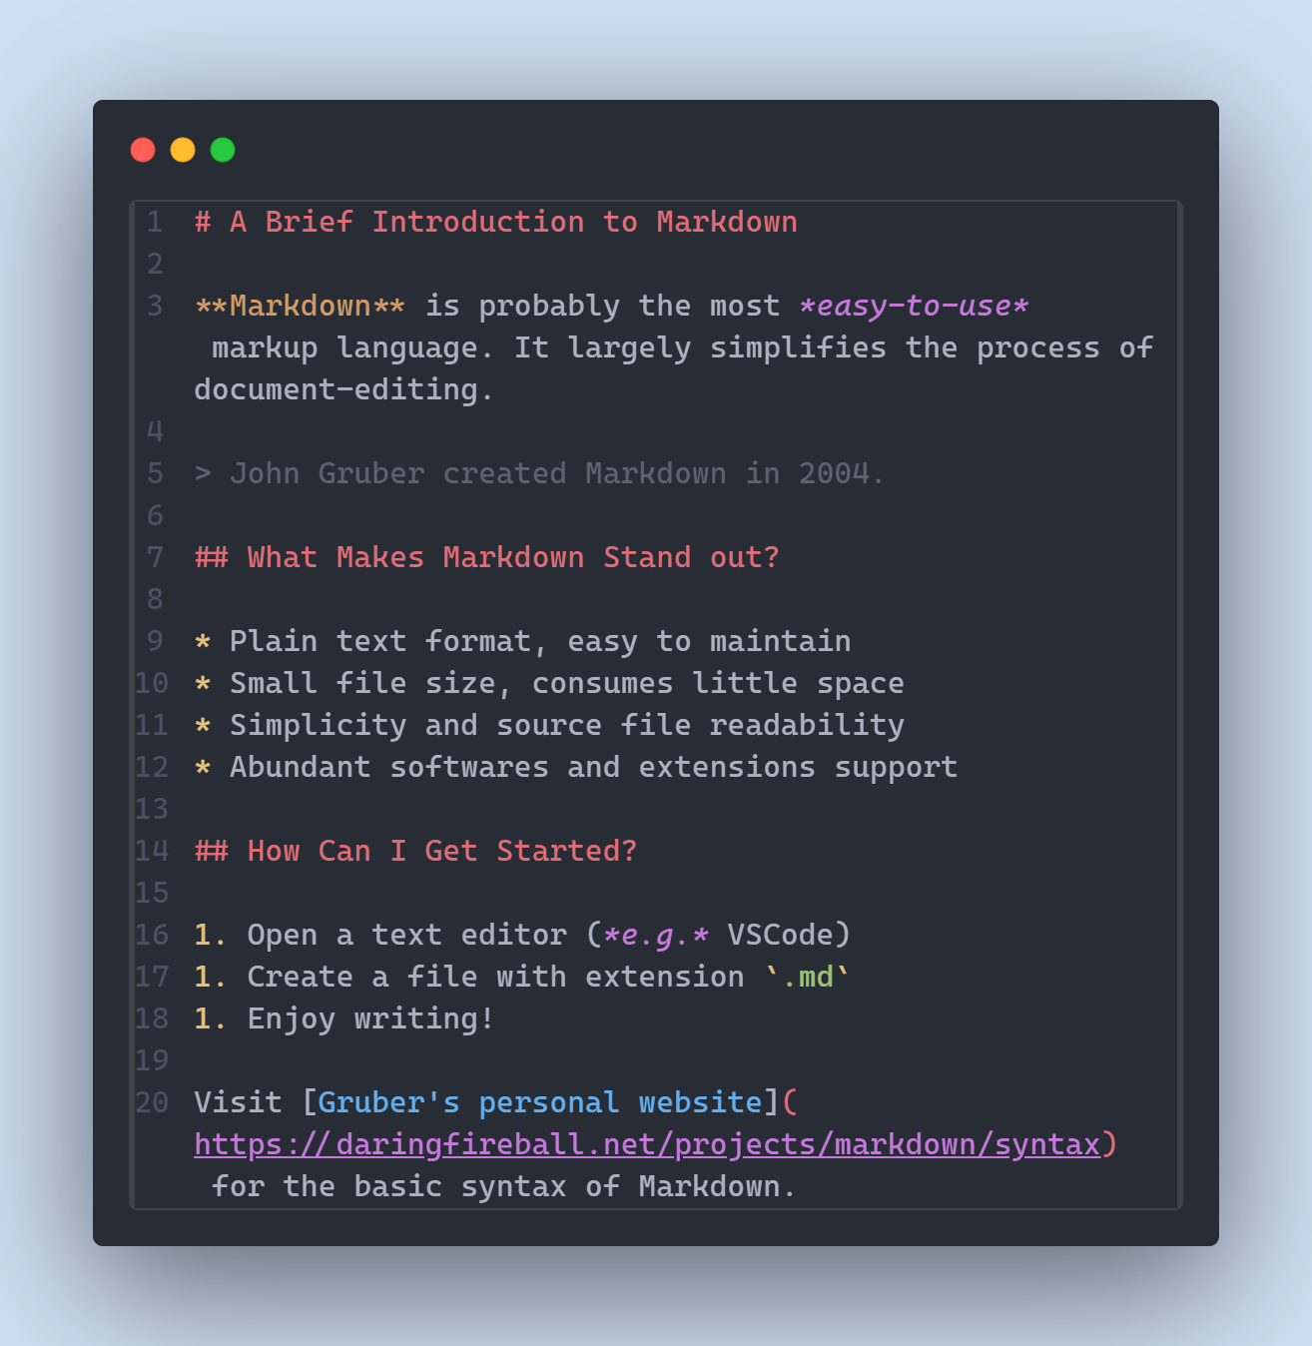
Syntax
Heading (1st level)
Italic
Bold
simple, clear, rich and extensible
Block quote
Heading (2nd level)
Unprecedented simplicity
Blends in well with the surrounding context
Readable and understandable in plain text form
Extensible, with variants derived from CommonMark standard
Bullet list
Ordered list
Inline code
Hyperlink

Slide 13
Format | Effect | Syntax
 |  | HTML | LaTeX | WikiText | Markdown
Bold | text | <strong>text</strong> | {\bf text} | '''text''' | **text**
Italic | text | <em>text</em> | {\it text} | ''text'' | *text*
Heading | Level 1 Level 2 Level 3 | <h1>Level 1</h1> <h2>Level 2</h2> <h3>Level 3</h3> | \title{Level 1} \maketitle \section*{Level 2} \subsection*{Level 3} | =Level 1= ==Level 2== ===Level 3=== | # Level 1 ## Level 2 ### Level 3
Bullet list | Item 1 Item 2 Item 3 | <ul> <li>Item 1</li> <li>Item 2</li> <li>Item 3</li> </ul> | \begin{itemize} \item Item 1 \item Item 2 \item Item 3 \end{itemize} | * Item 1 ** Subitem 1 ** Subitem 2 * Item 2 * Item 3 | * Item 1 * Subitem 1 * Subitem 2 * Item 2 * Item 3
Ordered list | Item 1 Item 2 Item 3 | <ol> <li>Item 1</li> <li>Item 2</li> <li>Item 3</li> </ol> | \begin{enumerate} \item Item 1 \item Item 2 \item Item 3 \end{enumerate} | # Item 1 ## Subitem 1 ## Subitem 2 # Item 2 # Item 3 | 1. Item 1 1. Subitem 1 1. Subitem 2 1. Item 2 1. Item 3
Hyperlink | link | <a herf="https://www.wikipedia.org/">link</a> | \href{https://www.wikipedia.org/}{link} | [[A Page|link]] [https://www.wikipedia.org/ link] | [link](https://www.wikipedia.org/)
Inline code | code | <code>code</code> | \verb|code| | <code>code</code> | `code`
Lightweight Markup Languages
Markdown’s simplicity

Slide 14
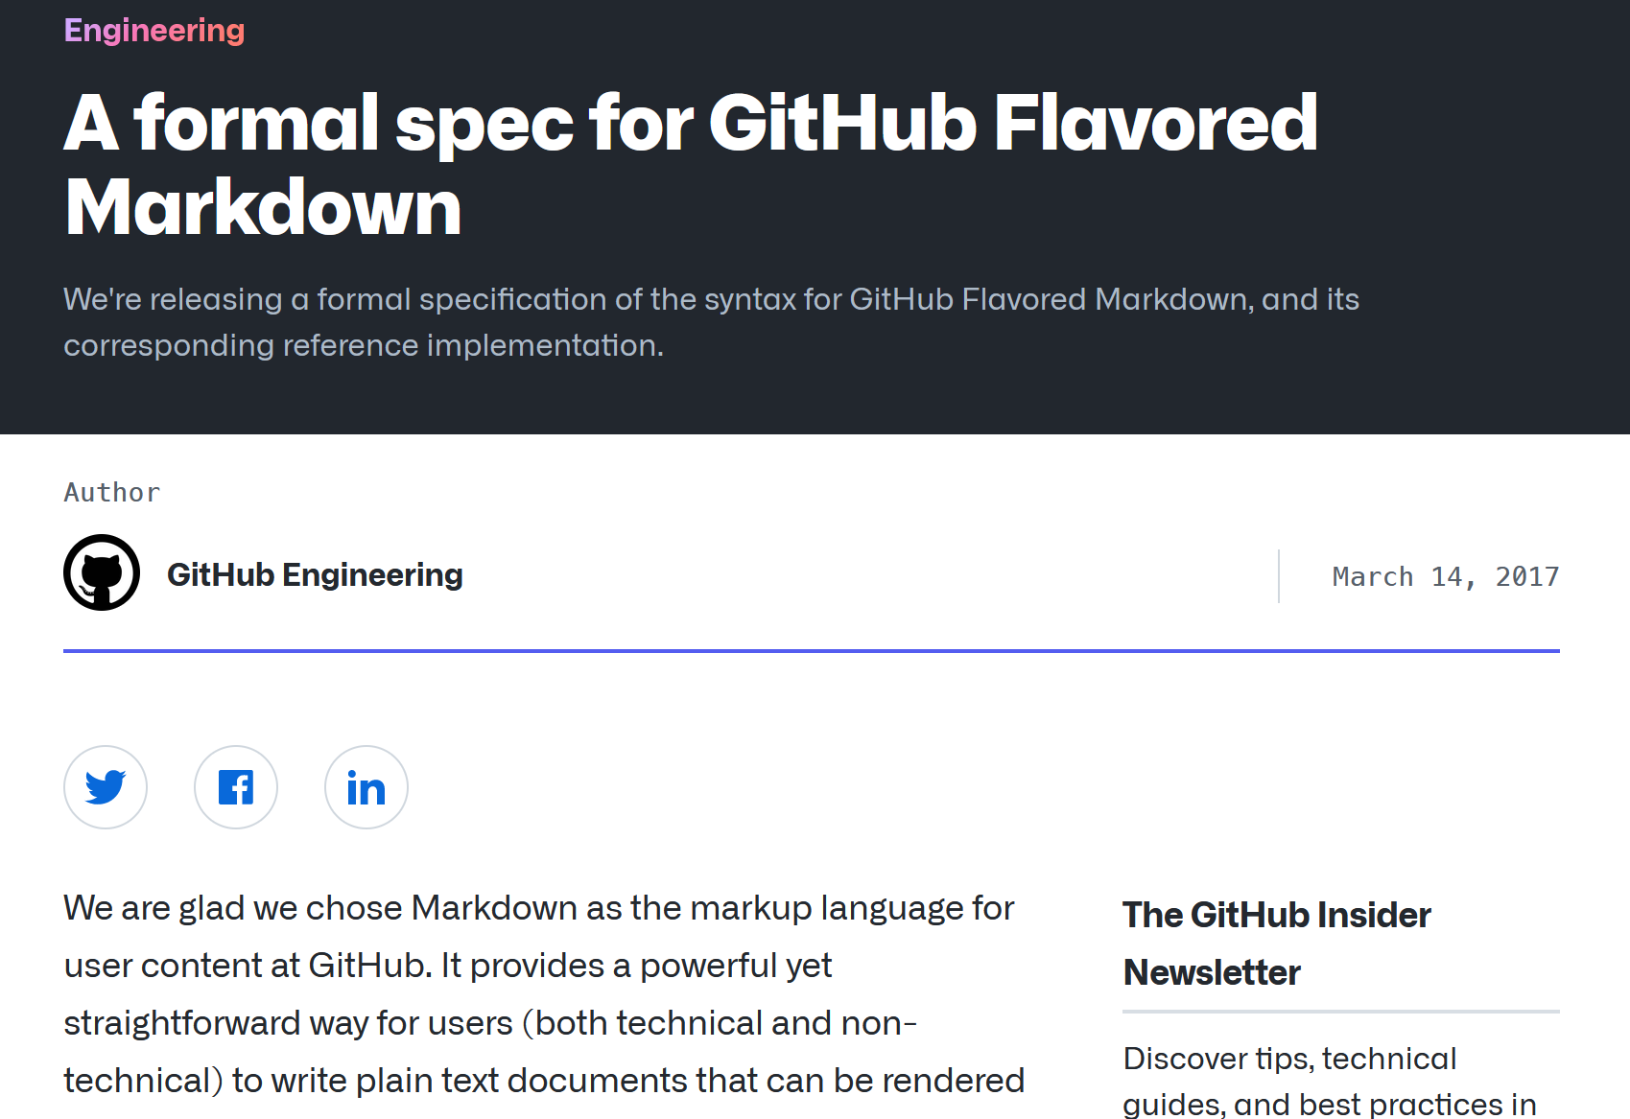
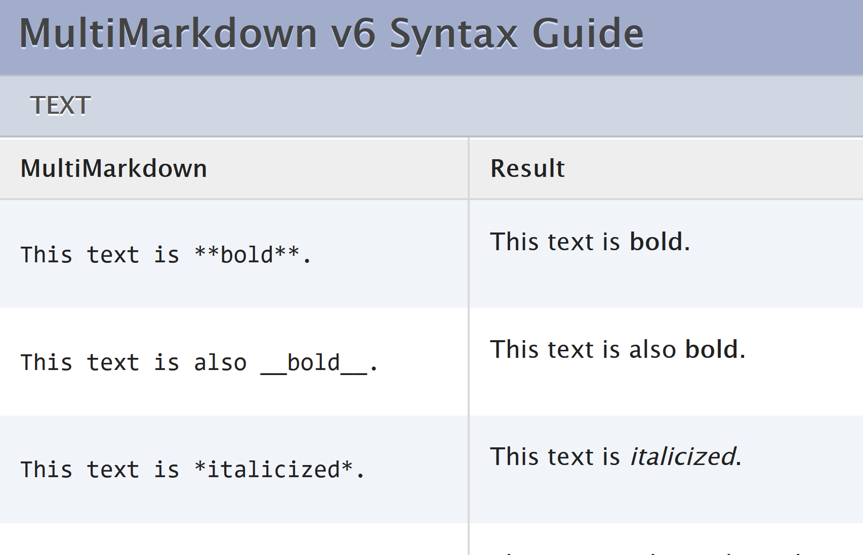
Syntax Extensibility
GitHub Flavored Markdown (GFM)
MultiMarkdown (MMD)
CommonMark + table, to-do list, strikethrough, etc.
CommonMark + superscript and subscript, LaTeX formula, footnote, etc.

Slide 15
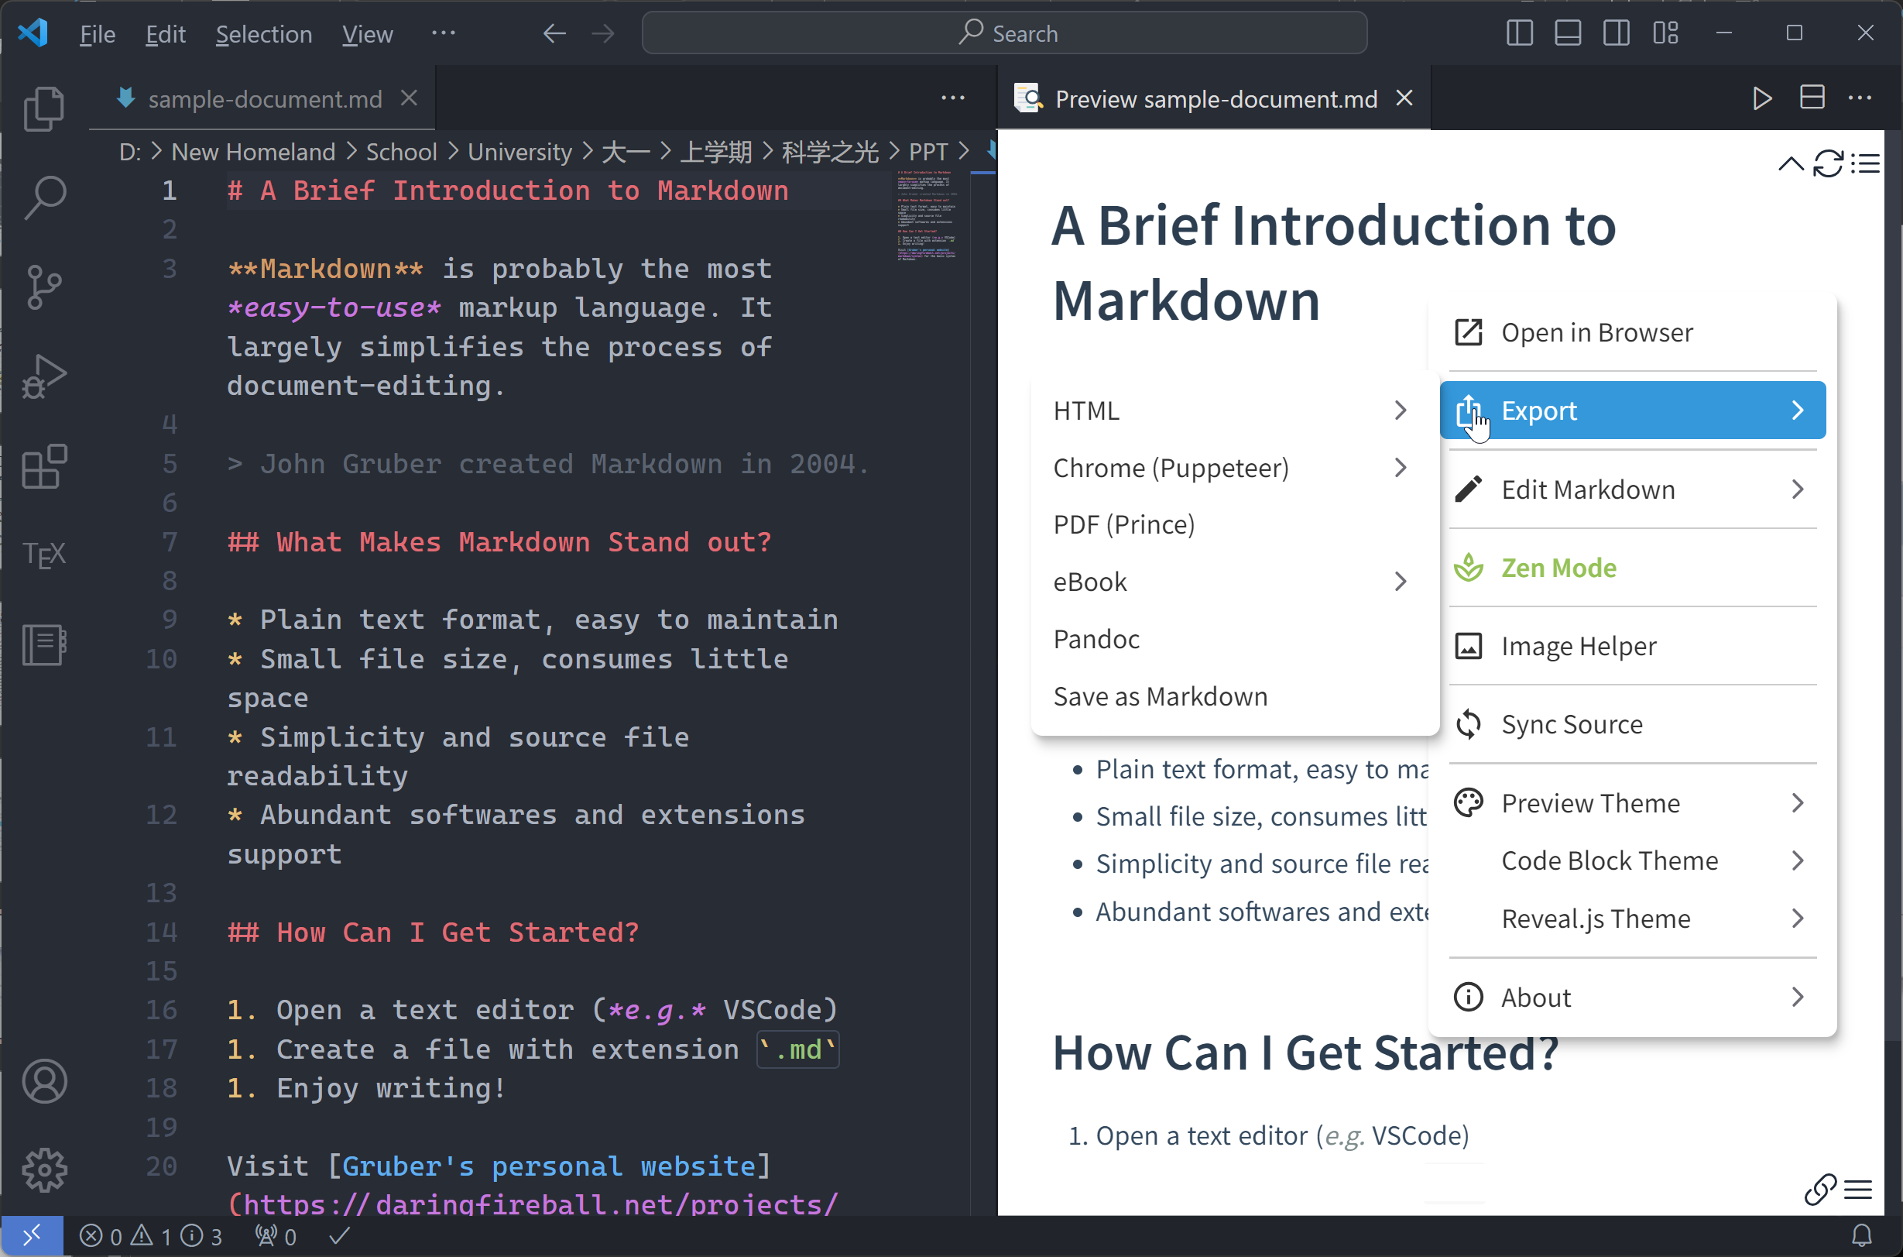
VSCode plugin Markdown Preview Enhanced (MPE)
Other Advantages
Exchangable with other formats: HTML, PDF, .docx, ePub, etc.
Softwares and extensions support, with VSCode plugin Markdown Preview Enhanced as a typical example

Slide 16
Markdown Preview Enhanced (MPE)
Introducing MPE
Markdown standard: a fusion of GMF and MultiMarkdown
Exporting to various formats
customizable CSS stylesheet
Importing outer files
Inserting graphs with tools like Mermaid and Vega Lite
Create your own syntax by editing a parser.js script.

Slide 17
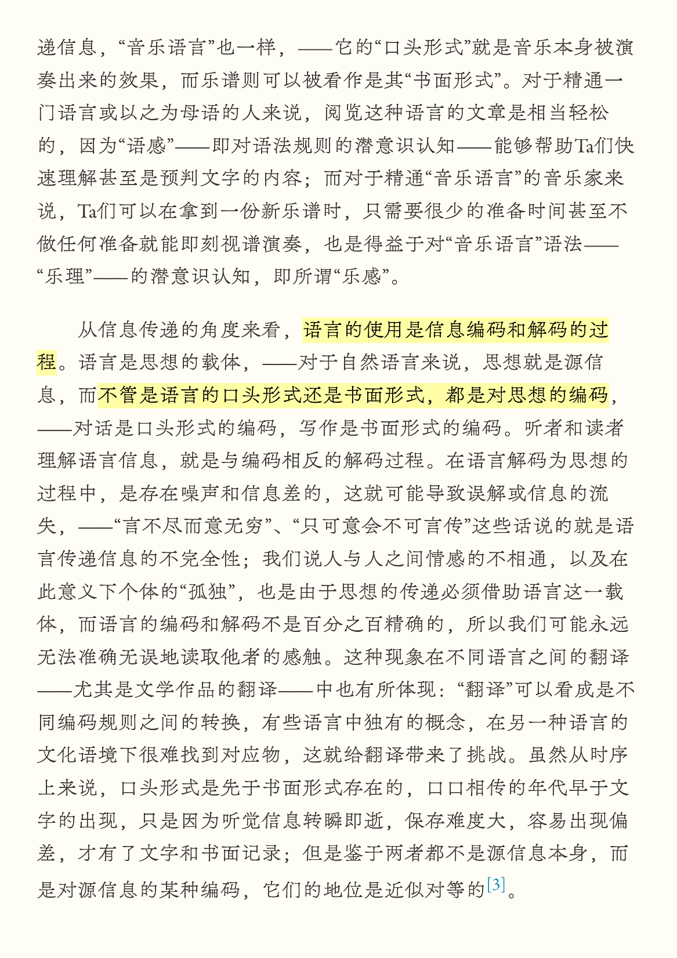
Conclusion: Advantages of Markdown
A document exported using MPE
Design principle: readability, easy-to-read and easy-to-write
Syntax: simple, clear, rich extensible
CommonMark standard provides a reliable specification of Markdown syntax
Other advantages
Exchangeable with various formats
Softwares and extensions support

Slide 18
Thank you for listening!

